Slide 1

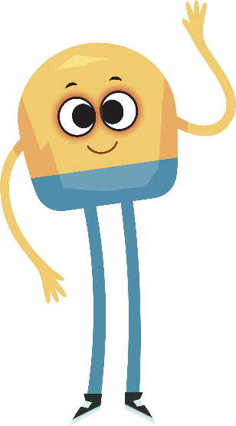

Unit 2: Week 3
Grade K

Slide 2
Copyright © Savvas Learning Company LLC. All Rights Reserved.
This publication is protected by copyright, and permission should be obtained from the publisher prior to any prohibited reproduction, storage in a retrieval system, or transmission in any form or by any means, electronic, mechanical, photocopying, recording, or otherwise. For information regarding permissions, request forms, and the appropriate contacts within the Savvas Learning Company Rights Management group, please send your query to:
Savvas Learning Company LLC, 15 East Midland Avenue, Paramus, NJ 07652
or
k12learningpermissions@savvas.com
myView Literacy® is an exclusive trademark of Savvas Learning Company LLC in the U.S. and/or other countries.

Slide 3

Lesson 1

Slide 4
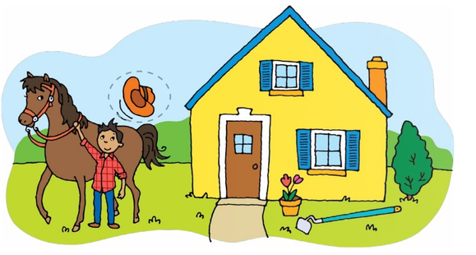
Page 92
Phonological Awareness
Notes:
See and Say: Have students turn to p. 92 in the Student Interactive. Explain that they will circle pictures that begin with the sound /h/.
Practice with the word hat. Name each picture on p. 92 with students
Then have them circle the pictures that begin with the sound /h/
Say: Now I will say a sentence. I will clap for each word in the sentence. Listen for each word: The hat came off. What are the words in that sentence? (the, hat, came, off)
Repeat with other simple sentences

Slide 5

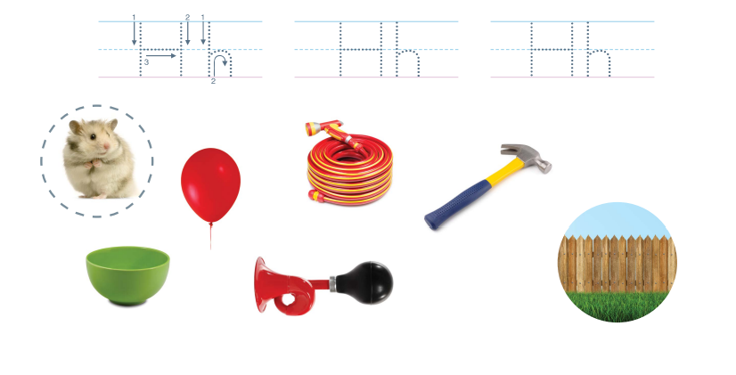
Page 93
Phonics
Notes:
1. Display Alphabet Card Hh. Point to the picture of the helicopter. Have students say helicopter with you. Point to the letters Hh on the Alphabet Card.
2. Tell students the word helicopter begins with the sound /h/, so it begins with the letter h.
3. Model how to form the letters H and h. Then have students trace the letters at the top of p. 93 in the Student Interactive
4. Tell students to listen for the beginning sound /h/ spelled h and trace the letter in the air when they hear the sound.
5. Tell them to keep their hands on their desk for words that do not start with the letter h. Use the following words for this activity, emphasizing the initial sound: hop, toss, ham, hail, hip, pit, had.
6. Have students look at p. 93 in the Student Interactive. Direct them to the first picture. Say the word hamster. Does this word begin with the sound /h/? Yes, so we will circle it.
7. Tell students to complete the activity.

Slide 6
High-Frequency Words
one
two
three
Notes:
Display the high-frequency words one, two, and three.
Point to each word as you read it.
Have students point to the word one and read it.
Repeat for two and three.

Slide 7
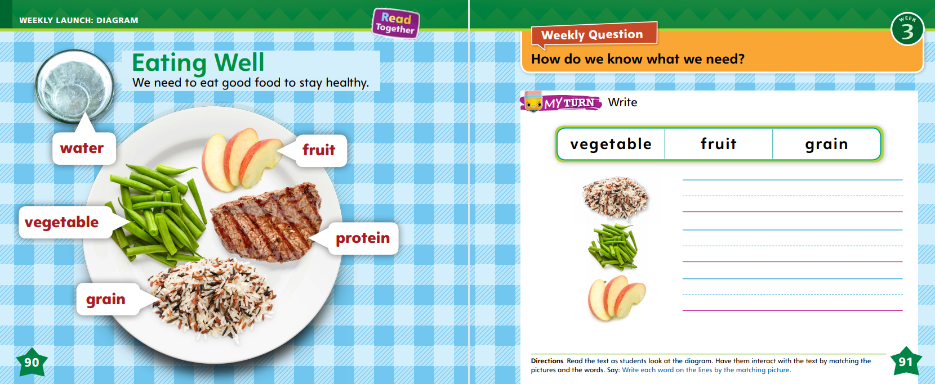
Page 90,91
Interact with Sources
Essential Question: What do living things need?
Weekly Question: How do we know what we need?
Notes:
Remind students of the Essential Question for Unit 2: What do living things need? Point out the Week 3 Question: How do we know what we need?
Tell students that this week, they will learn about how we know what we need.
Ask students to tell you what they see on pp. 90–91 of the Student Interactive.
Read aloud the heading and the sentence below it.
Then read each label and have students point to the picture of each item. Use the following questions to prompt discussion:
• What foods do you see on the plate?
• Green beans are a vegetable. What are some other vegetables?
• Meat is a protein. What are some other proteins?
• An apple is a fruit. What are some other fruits?
• What foods should we eat to stay healthy?
Read aloud the words in the box on p. 91 of the Student Interactive.
Have students interact with the text and photos on pp. 90–91 by writing the correct word next to each picture on p. 91.
Remind students of the Week 3 Question: How do we know what we need?
Discuss the question with them and explain that they will read more about what people and animals need to live.

Slide 8
Listening Comprehension
Characters (who?) | Setting (where?) | Plot (what happens?)
Notes:
Tell students that they will listen to you read a story. Tell students that a story that is made up is called fiction.
There are many different kinds of fiction, or stories. Listening to stories can be fun. Have students listen as you read aloud the story “Pedro and Maria’s Camping Adventure.”
Tell students to be active listeners by looking at you and thinking about what you are saying as you read aloud.
Read: the entire text aloud without stopping for the Think Aloud callouts.
Reread: the text aloud, pausing to model Think Aloud strategies related to the genre.

Slide 9
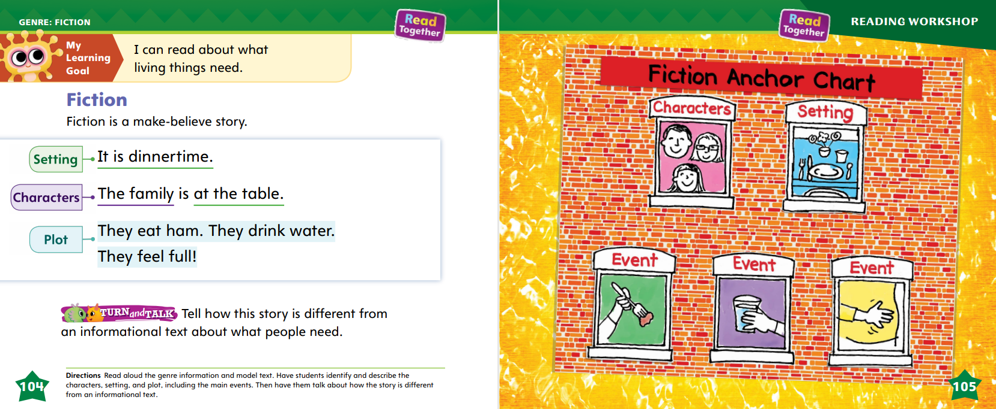
Page 104,105
Fiction
Notes:
Tell students that they will talk about fiction texts, or stories. Explain that fiction is a story that is made up.
• Fiction texts, or stories, have settings. A setting includes where the story takes place. It also includes when the story takes place.
• Fiction texts, or stories, have characters. Characters are the people or animals that are in a story.
• Fiction texts, or stories, have plots, or events. A plot, or set of events, is what happens in a story.
Read aloud the model fiction story on p. 104 in the Student Interactive. Model for students the elements of fiction. The setting of fiction, or a story, tells where the story is happening. It also tells when. In this story, the setting is at the family table, and it is dinnertime. Characters are the people or animals that are in a story. The characters in the story on page 104 are the family members. A plot is what happens in a story. A plot has events. In this story, the first thing that happens is that the family eats ham. Then they drink water. Last, the family feels full. This little story is fiction. It is a story that is made up, and it has a setting, characters, and plot events.
Read the Anchor Chart together on p. 105.
Read the Anchor Chart on page. 105 in the Student Interactive together. Editable Anchor Chart Click Path: Table of Contents -> Reading Anchor Charts -> Unit 2 Week 3: Informational Text Editable Reading Anchor Chart

Slide 10
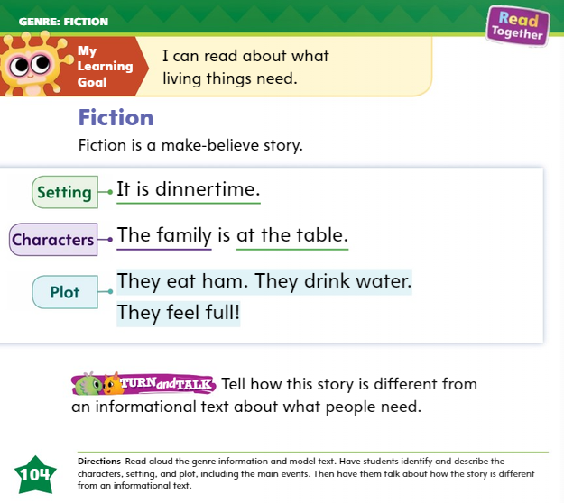

Page
104
Apply
Tell how this story is different from an informational text about what people need.
Notes:
Have students turn and talk with a partner to discuss how the story on p. 104 is different from an informational text about what people need.

Slide 11
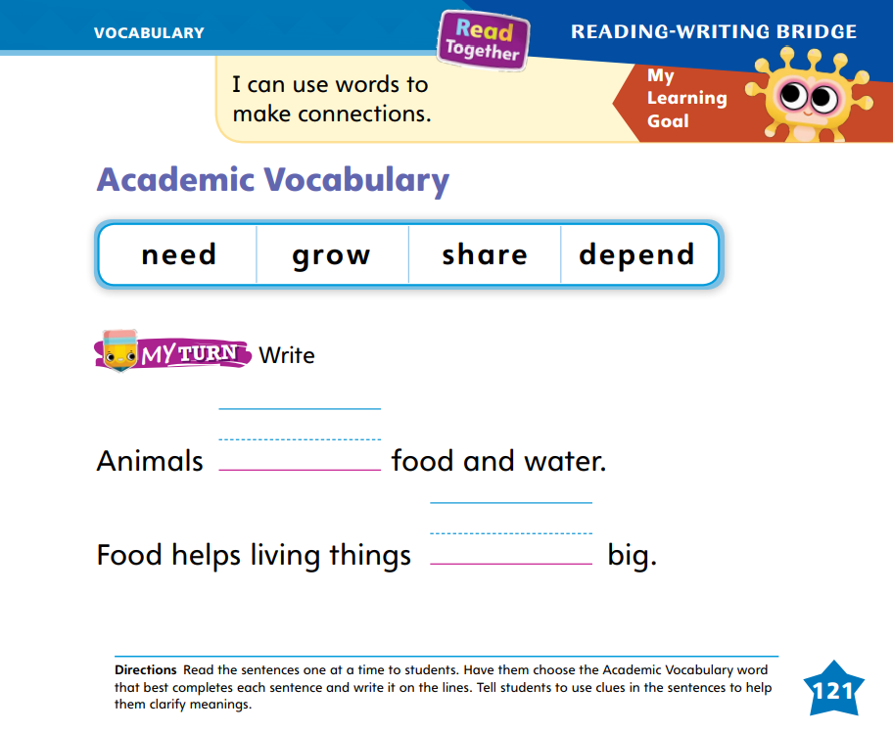
Page 121
Academic Vocabulary
Turn to page 121 in your Student Interactive and complete the activity.
Notes:
Explain to students that they can use clues to help them understand a word they do not know.
Sometimes you can look at picture clues. What do you see in the picture that can help you figure out what a word is?
Sometimes you can look at context clues, or details in the other words. What other words in the sentence do you know? Can they help you figure out the word that you don't know?
Have students turn to p. 121 in the Student Interactive. Read aloud the academic vocabulary words with students. Define the words if needed.
Provide this sentence: I can _____ my book with my friend. Read aloud the sentence, without reading the missing word. Model how you use the context to figure out a word. I can use the context clues, or the other words in the sentence, to help me figure out which word goes in the blank. I know what a book is, and I know what a friend is. What could I do with my book and my friend? I can share my book with my friend.

Slide 12
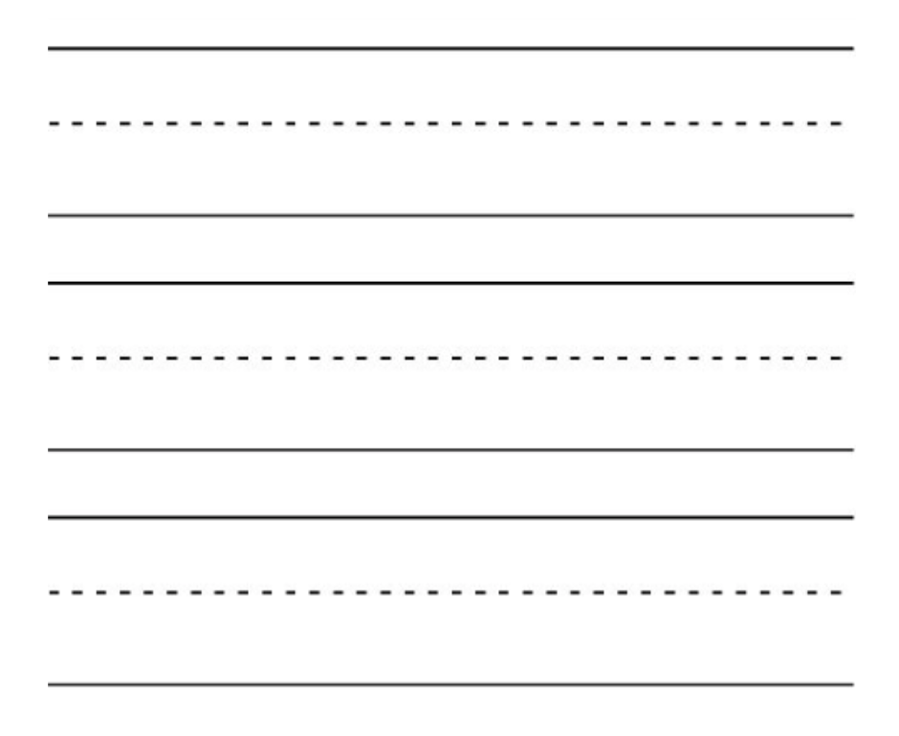
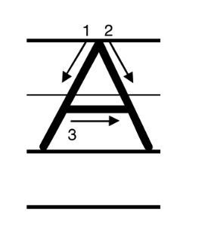
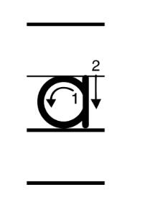
Handwriting
Notes:
Display uppercase and lowercase Aa. Have students identify the letters.
Model how to write the uppercase letter A. Show students where to begin the letter, what to do next, and how to finish it.
Have students practice writing the letter in the air with their fingers. Then repeat with the lowercase letter a.
Have students use Handwriting p. 80 from the Resource Download Center to practice writing the letters Aa. Click path: Realize -> Table of Contents -> Resource Download Center -> Handwriting Practice -> U2W3L1 Handwriting Practice

Slide 13
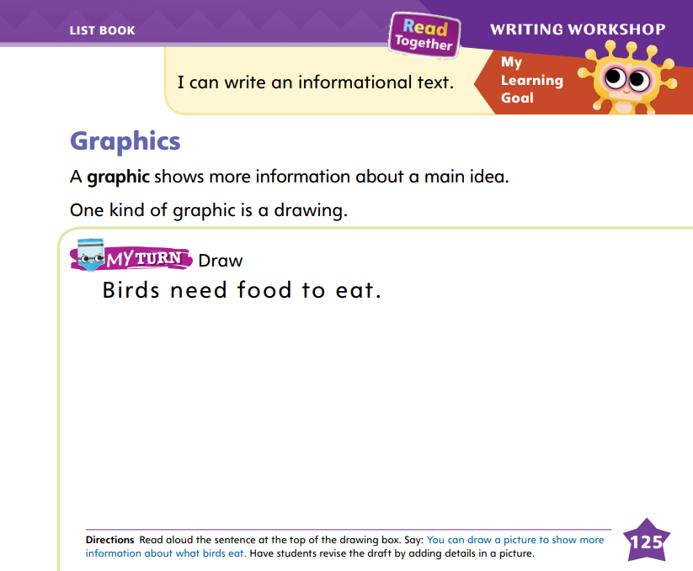
Page 125
Writing – List Book
Turn to page 125 in your Student Interactive and complete the activity.
Notes:
Books include graphics to help give information. Graphics show more details about a topic or show something specific about a detail. When authors write a book, they decide:
• What kind of graphics to include
• If they should include photographs or drawings
• What kind of details to add to their drawings
Inform students that graphics are an important part of list books and other kinds of books. Say: Graphics, like drawings, make books interesting to read. We can look at the graphics to learn more details about a book’s main idea. The author can use graphics to tell us more information without using any words!
Page through a stack text that shows illustrations. Point out the graphics used in the book, starting with the cover.
Talk through what you see in each drawing and what details you identify in the pictures. Identify the main idea of the text and how the graphics illustrate the main idea.
Have students turn to p. 125 in the Student Interactive. Read through the activity together and have students draw a picture to show information about the topic.
When they are finished drawing, help them understand that the sentence does not tell the reader what food birds eat, but the graphic shows food.
The reader gets more information about the sentence because of what’s shown in the graphic. Then have students revise their drafts by adding details in the picture.

Slide 14

Independent Writing
Review your list books.
Add graphics on each page.
Revise your draft by adding more details and graphics
Continue writing
Notes:
After reviewing stack books with graphics, students should review their list books and add graphics on each page.
If students struggle, choose one of the following options to provide further support.
Modeled: Think aloud about what to draw to match the topic.
Shared: Together, come up with details to include in the graphic.
Guided: Prompt students to expand on the topic by providing lots of details in their drawings.
If students have finished adding graphics, direct them to revise their drafts by adding more details to the graphics. Then they can continue writing.

Slide 15
Language and Conventions
The boy is big.
This is a good book.
Practice finding adjectives.
Notes:
Review adjectives from the Language & Conventions lesson. See pp. T338–T339.
Provide this sentence for students: The boy is big. Read aloud the sentence, pointing to each word. I remember that an adjective describes a noun. The word big is an adjective because it tells about the boy.
Underline the word boy and circle the word big.
Provide another sentence: This is a good book. Read aloud the sentence with students. Ask: What is the article? What is the adjective? What does the adjective describe? Circle the adjective as students name it.
Call on different students to give examples of adjectives to describe a book.

Slide 16
Lesson 2

Slide 17
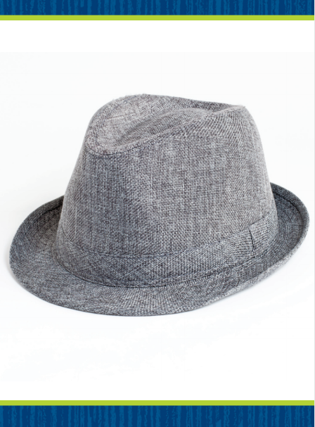
Page 94
Phonics
Notes:
Hold up Picture Card hat. This is a picture of a hat. I hear the sounds /h/ /a/ /t/. The letter h spells the sound /h/ at the beginning of hat. Say the sound /h/ with me.
Display the word hat. Read the word, pointing to each letter as you say the sound: /h/ /a/ /t/. This is the word hat. The word hat has the beginning sound /h/ spelled h. You can read this word, and you can write this word.
Point to the word hat and have students read it. Then guide them to say each letter as they write it in the air. Repeat with the words hot, hid, ham, hop, hip, had.

Slide 18
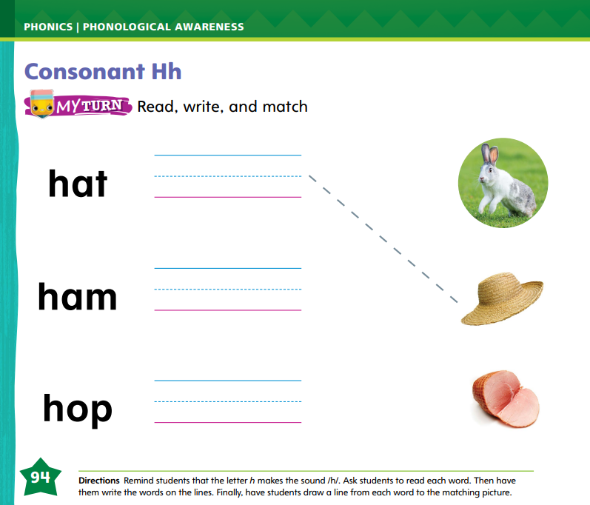
Page 94
Apply
Turn to page 94 in your Student Interactive and complete the activity.
Notes:
Have students complete p. 94 in the Student Interactive.
They should read each word, write it on the lines, and then draw a line to match each word with the picture that shows the word.

Slide 19
High-Frequency Words
one
two
three
Notes:
Tell students that high-frequency words are words that they will hear and see over and over in texts.
Write and read the sight words one, two, and three.
Have students
• repeat the words after you.
• spell each word, tapping their knees as they say each letter.

Slide 20
Page 106
Preview Vocabulary
food
water
shelter
Notes:
Read aloud the vocabulary words on p. 106 of the Student Interactive with students: food, water, shelter. Ask students what they know about these words.
Give definitions for the words. (food is something we eat; water is a liquid we drink every day; shelter is a place to live and be safe)
Prompt students to share what they know about the words. Ask questions such as: What is an example of a food? Why do we need water? What is an example of a shelter?
Explain that students will come across these words in their reading.

Slide 21
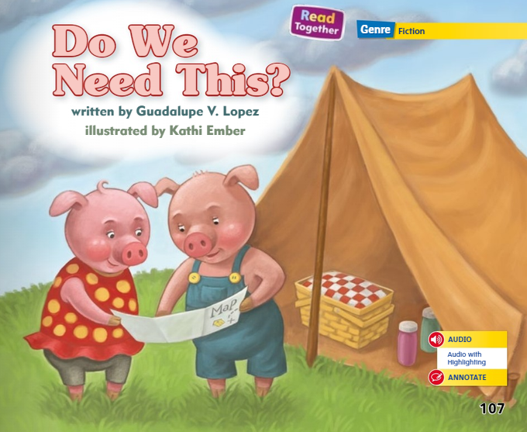
Page 107
Print Awareness
Notes:
Tell students that there is a correct way to hold and handle a book. Hold a book upside down and say: I cannot read the book when I hold it this way! Turn the book right side up. Then ask students what they can do to get to the next page.
Tell them that they can turn the page, and that they should turn the page carefully and in a correct order without skipping. Have students practice holding their Student Interactive right side up and turning the pages carefully.

Slide 22
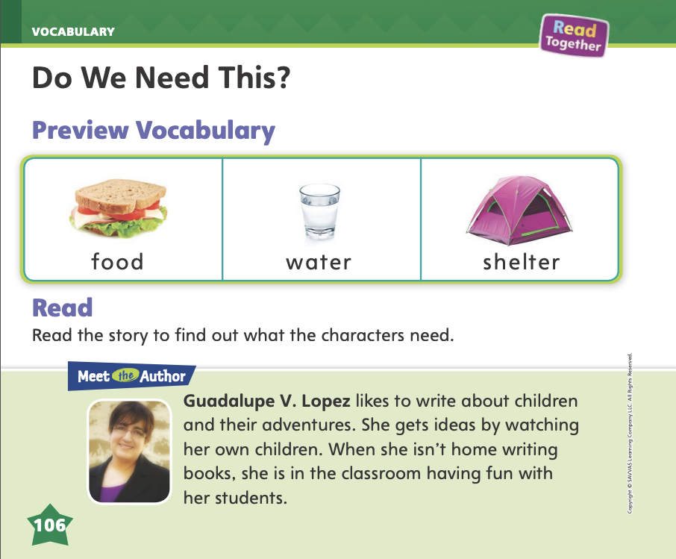
Page 106
First Read Strategies
Notes:
Have students point to the title of the selection and read it aloud with you. Have them point to the author’s and the illustrator's names.
Read aloud the information about the author on p. 106.
Then have students explain the role of the author and the illustrator in the story.
READ Listen and follow along to the text.
LOOK Look at the pictures to help understand the text.
ASK Generate, or ask, questions about the text to deepen understanding.
TALK Talk to a partner about the text.
Students may read the text independently, in pairs, or as a whole class.
Use the First Read notes to help students connect with the text and guide their understanding.

Slide 23
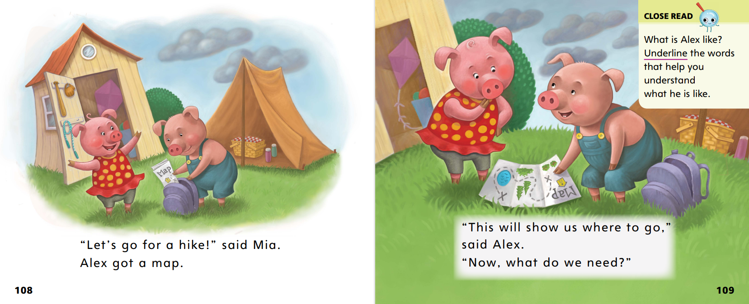

Page 108,109
First Read – Do We Need This?
Notes:
Read
THINK ALOUD After reading pp. 108–109, I know this story will be about two characters wanting to go hiking. They have a map, but they will need to bring other things too.

Slide 24
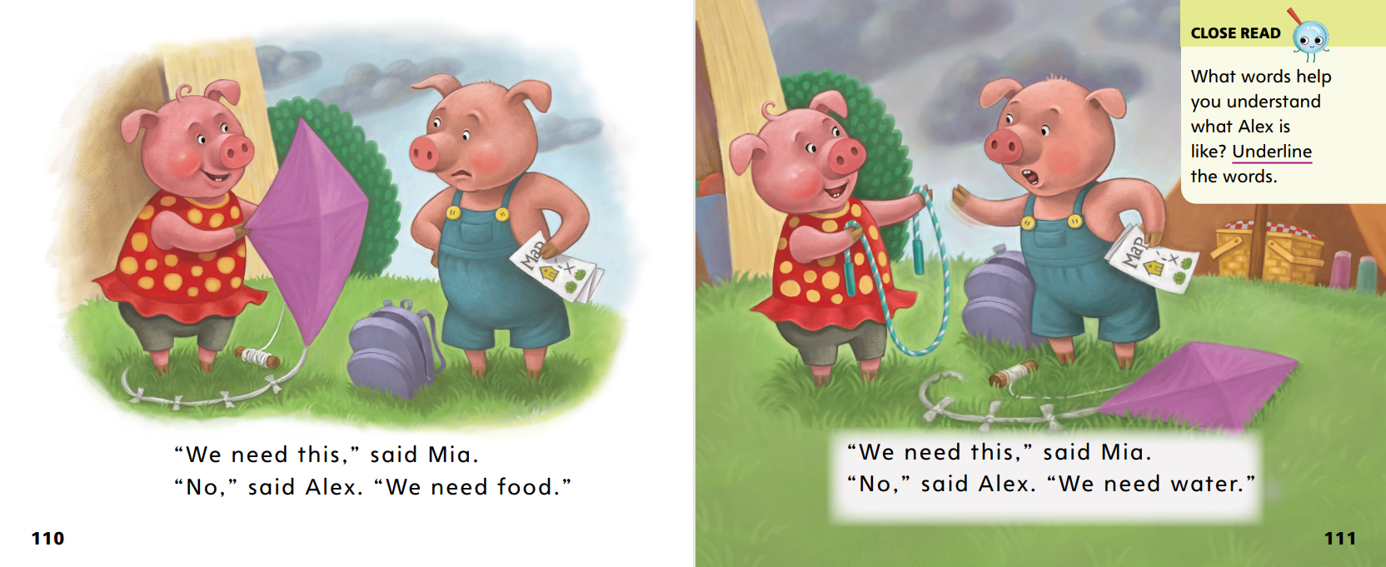
Page 110,111
First Read – Do We Need This?
Notes:
Read Together.

Slide 25
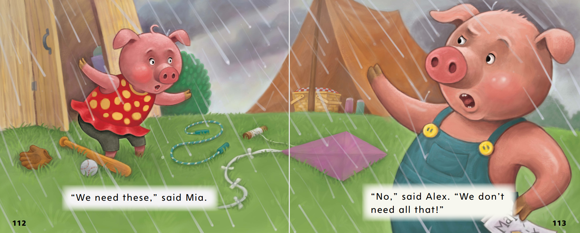
Page 112,113
First Read – Do We Need This?
Notes:
Ask.
THINK ALOUD I have a question about the illustration on p. 112: Why does Mia have the look on her face that she does? I can look at the other details in the picture to answer my question. It is raining in the picture, so maybe that surprised Mia. Now Mia and Alex can’t go hiking.

Slide 26
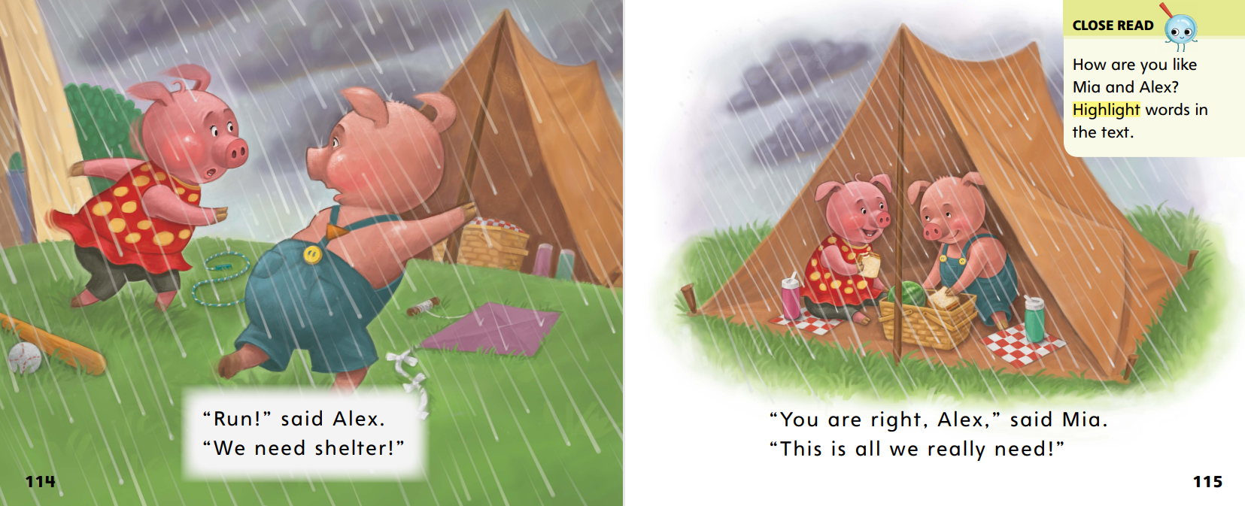
Page 114,115
First Read – Do We Need This?
Notes:
Read Together.

Slide 27
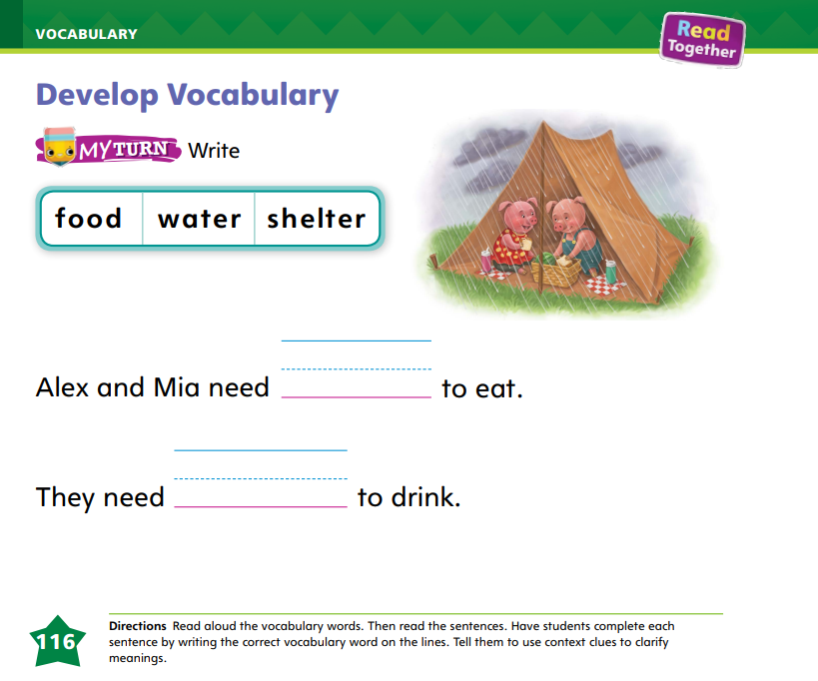
Page 116
Develop Vocabulary
Turn to page 116 in your Student Interactive and complete the activity.
Notes:
Remind students that they can use context clues to clarify the meanings of new or difficult words. Sometimes context clues are other words nearby in the text.
• Read and Search: Read the word and then search for other words nearby whose meanings you already know.
• Think: Think about how the nearby words that you know tell more about the word you don't know to figure out the meaning of the new word.
Have students look at the sentences on p. 116 in the Student Interactive. I can use the sentence to help me figure out the missing word. The words to eat are a clue that the missing word is food.
Ask students to write the word food. Have students read the sentence aloud with you to check for meaning.

Slide 28
Page 117
Check for Understanding
What lesson does Mia learn?
Why do you think the author wrote this text?
Why do people need shelter?
Notes:
Have students complete the Check for Understanding on p. 117 in the Student Interactive.

Slide 29
Writing – List Book
Letters have thin spaghetti spaces between them.
Words have bigger meatball spaces between them.
Notes:
Letters have small spaces between them, and words have bigger spaces between them. You can use the concept of spaghetti and meatballs to teach spacing as students build their writing skills.
Explain that letters and words have spaces between them, and these spaces help readers understand what they are reading. Good writers use spacing to differentiate between letters, words, and sentences. Tell students that you will teach them how to leave spaghetti and meatballs as they write.
Copy this sentence on a flipchart: Letters have thin spaghetti spaces between them. In between each letter, draw a thin line using a yellow marker. Read the sentence out loud, tracking print with your finger. Explain to students that these thin lines represent spaghetti.
Write this sentence beneath the first sentence: Words have bigger meatball spaces between them. Between each word, use a brown marker to draw a small circle. Read the sentence out loud, tracking print with your finger. Explain to students that the circles represent meatballs.
Using a stack book, point out spaghetti and meatballs between letters and words. Have students review the stack book to visualize correct spacing between letters and words.

Slide 30
Independent Writing
Let’s review our list books for proper spacing between letters and words with our partners.
Notes:
As students write, tell them to use proper spacing between letters and words. Have them review their list books for proper spacing.
• Modeled: Use other elements to show spacing between words, like sticks and stones.
• Shared: Guide students to notice spacing in their writing efforts
• Guided: Prompt students to think of another way to remember spacing between letters and words.
As you confer with students one on one, use the Conference Prompts on p. T350

Slide 31
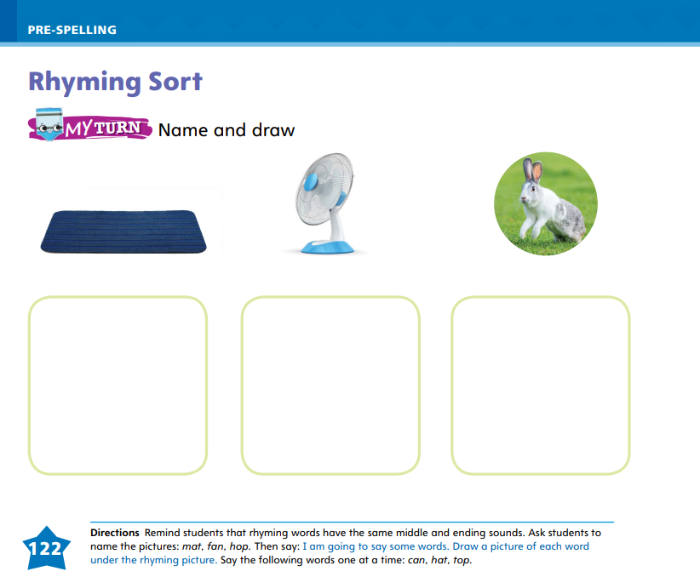
Page 122
Spelling
can
hat
top
Turn to page 122 in your Student Interactive and complete the activity.
Notes:
Explain that when words rhyme, they have the same middle and ending sounds, but different beginning sounds.
Say: Listen to these words: pin, tin. I know these words rhyme because they have the same middle sound, /i/, and the same ending sound, /n/. I can think of other words that rhyme with these words: win, fin.
Name the pictures on p. 122 in the Student Interactive with students. The word mat has /a/ in the middle and /t/ at the end. What rhymes with mat? Is it the word can, hat, or top?
Have children draw a picture of either a can, a hat, or a top, whichever one rhymes with mat.
Have students draw pictures of things that rhyme with the pictures on p. 122 in the Student Interactive. If students have trouble, guide them to say the picture names, and repeat the words can, hat, and top for them.

Slide 32
Language and Conventions
jump, run, eat, talk
Verbs tell actions
Notes:
Tell students that verbs tell actions. Give some examples: jump, run, eat, talk.
Perform an action, for example, walk. I walk. I am doing this now so I use the present tense verb walk.
Ask students to perform or pantomime an action, such as chewing, drinking, or talking.
Ask other students to use the present tense to tell what the student is doing: He/She chews, drinks, talks, etc.

Slide 33
Lesson 3

Slide 34
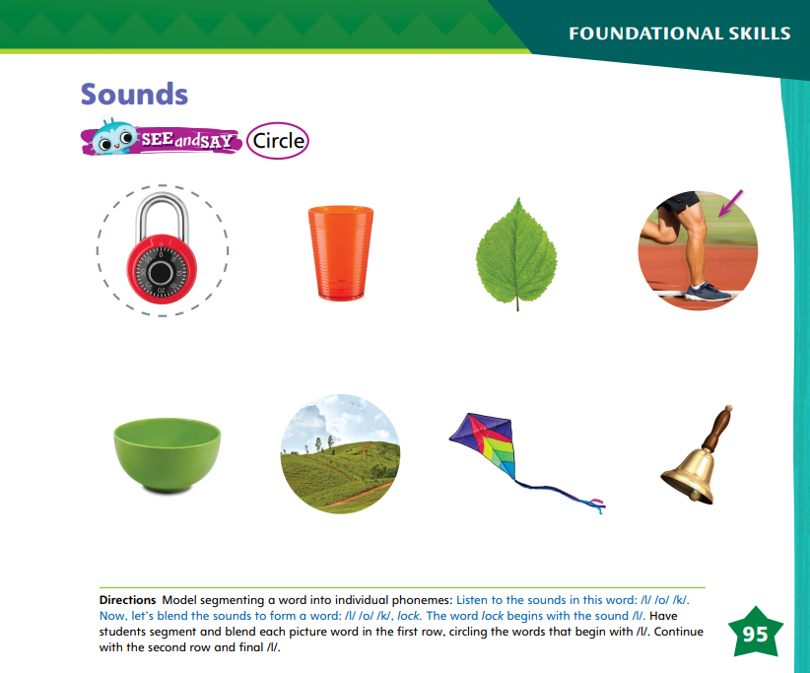
Page 95
Phonological Awareness
Notes:
Today we are going to learn a new sound. Listen carefully: /l/ /l/ /l/. You can make the sound /l/ by placing the tip of your tongue right above your two front teeth.
Show students how to make the sound /l/ and have them practice it. Make sure students are not adding the sound of short e to the beginning of the sound /l/. The letter l is said /e/ /l/, but that is not the sound /l/.
Have students turn to p. 95 in the Student Interactive. Explain that first, they will segment and blend the sounds in each word. Then they will circle picture words that begin with the sound /l/. Model with the word lock.
This is a picture of a lock. The sounds I hear in lock are /l/ /o/ /k/. I can blend the sounds /l/ /o/ /k/ to form the word lock.
Name each picture on p. 95 with students. Have them segment the individual phonemes and then blend the phonemes in each word. Then have them circle the pictures that begin with the sound /l/.

Slide 35
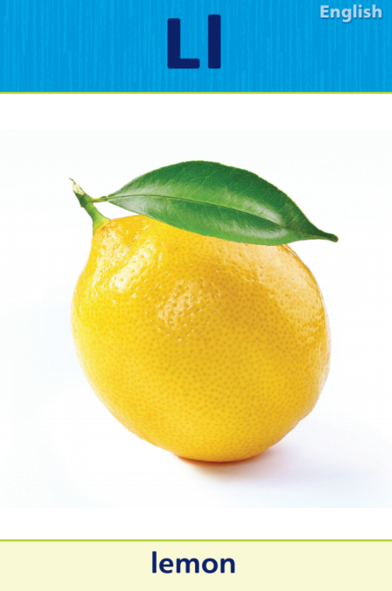
Page 96
Phonics
Turn to page 96 in your Student Interactive and complete the activity.
lip
Notes:
Tell students that the sound /l/ is spelled with the letter l. Display Alphabet Card Ll. Point to the lemon on the card and tell students the word lemon begins with l. Point to the letters on the card, and tell students the names of these letters are uppercase L and lowercase l.
Write uppercase and lowercase Ll on the board and slowly trace the letters as you say the sound /l/.
Have students turn to p. 96 in the Student Interactive.
Let’s look at the first picture and listen to the beginning sound in the word lip: /l/ -ip. The word lip begins with the sound /l/, and that sound is spelled with the letter l. Let’s circle the picture of the lip because the word starts with the sound /l/, and then we’ll trace the uppercase letter L and the lowercase letter l below the picture of the lip.
Have students complete the activity on p. 96 in the Student Interactive.

Slide 36
Page 97
High-Frequency Words
one
two
three
Turn to page 97 in your Student Interactive and complete the activity.
Notes:
Tell students that they will work again today with the high-frequency words one, two, and three. Words like one, two, and three are words that you need to practice reading.
Have students read the words at the top of p. 97 in the Student Interactive with you: one, two, three.
Have students identify and point to each word when you say it. Say two. Pause to let students find and point to the word. Say one. Say three. Repeat the activity until students are familiar with each word. Encourage students to use the words in sentences.
Have students read the sentences on p. 97 with you.
Ask them to identify the words one, two, and three in the sentences and underline the words one, two, and three.
Then have them read the sentences with a partner.

Slide 37
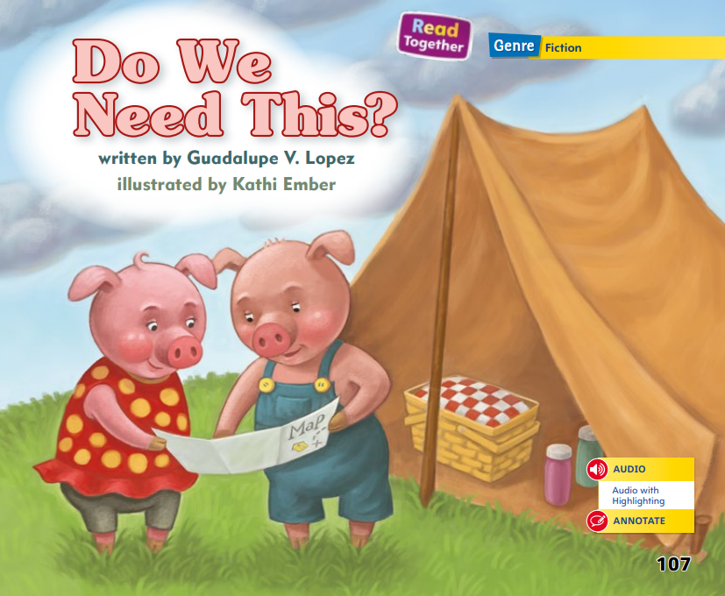
Page 107
Identify and Describe Characters
Notes:
Explain that characters are the people or animals in a story. They are who the story is about.
• Explain that readers can learn about characters by paying attention to what they say.
• They can also learn about characters from the things they do.
• Tell students that sometimes the illustrations give clues about a character.
Ask students to name the two characters in the story Do We Need This? (Alex and Mia)
As I read the story, I can find out about the characters. First, I can pay attention to what the characters say. I notice that Alex gets a map and says, "This will show us where to go." He also says, "We need food" and "We need water." Because of what he says, I learn that Alex knows a lot about camping. Next, I can look at what the characters do. Mia keeps bringing Alex the wrong things to take hiking. Because of what she does, I learn that Mia doesn't know much about camping. I can also find out about the characters by looking at the illustrations. I can see in the illustrations that Alex is frowning at Mia. By looking at the pictures, I learn that Alex is a little frustrated with Mia.

Slide 38
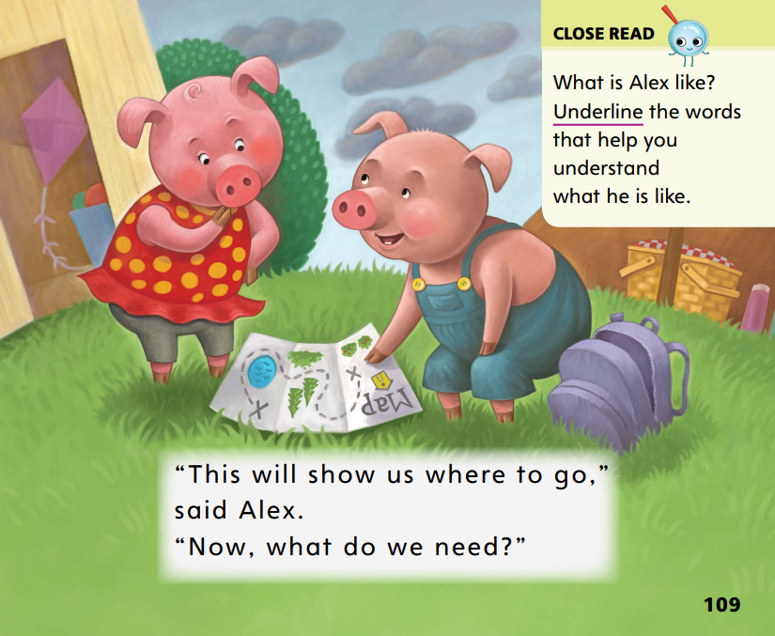
Page 109
Close Read – Identify and Describe Characters
Turn to page 109 in your Student Interactive.
Notes:
Tell students that they can use these strategies to learn about characters and describe, or tell about, them.
Have students read the Close Read notes on pp. 109 and 111 in the Student Interactive and underline words that tell them more about Alex.

Slide 39
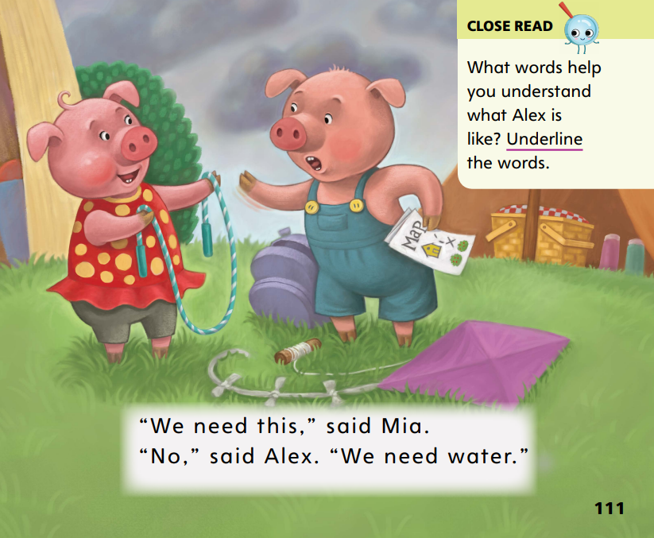
Page 111
Close Read – Identify and Describe Characters
Turn to page 111 in your Student Interactive.
Notes:
Tell students that they can use these strategies to learn about characters and describe, or tell about, them.
Have students read the Close Read notes on pp. 109 and 111 in the Student Interactive and underline words that tell them more about Alex.

Slide 40
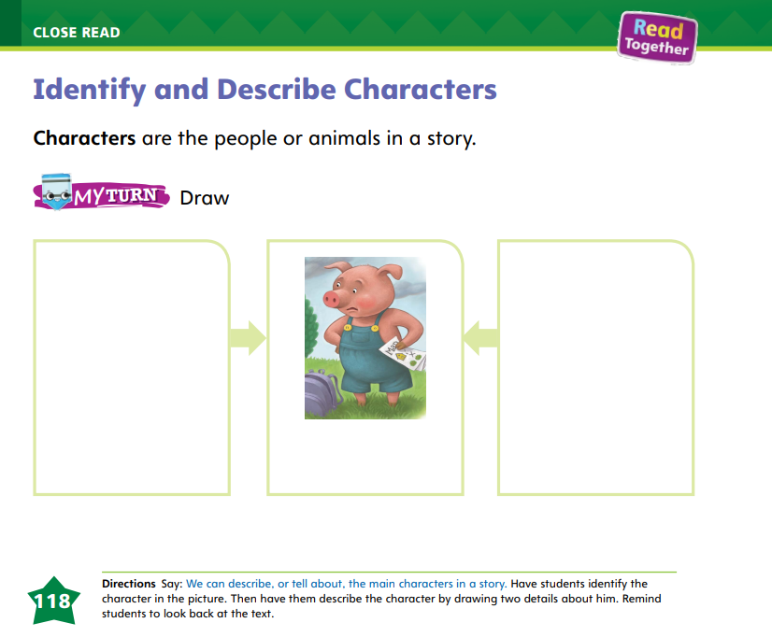
Page 118
Identify and Describe Characters
Turn to page 118 in your Student Interactive and complete the activity.
Notes:
Then have them turn to p. 118 in the Student Interactive and talk as a class about what students know about the character of Alex.
Have students use the strategies for identifying and describing characters.
Have students draw pictures of Alex showing two things about him on p. 118 in the Student Interactive. Support students as needed.

Slide 41
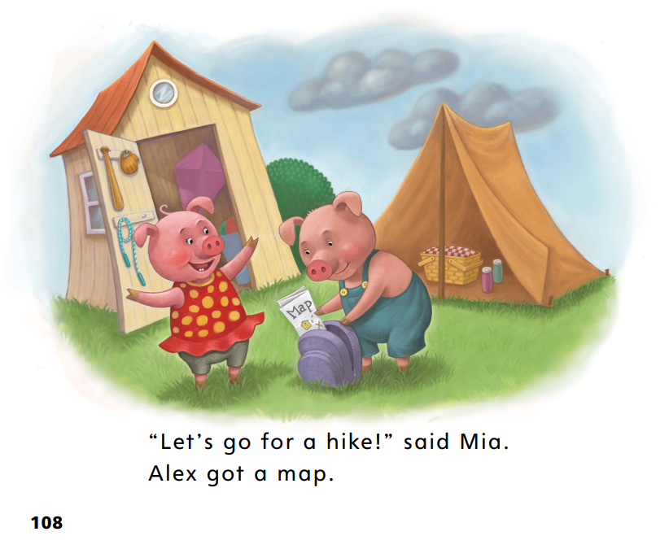
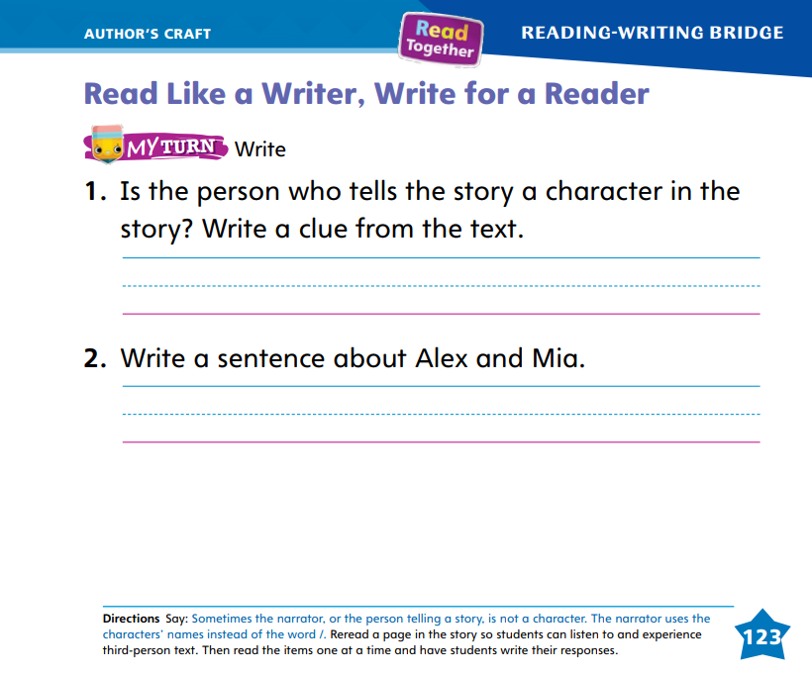
Page 108,123
Read Like a Writer, Write Like a Reader
Notes:
Remind students that first-person text is when a character uses I and me to tell the story. Third-person text is when the author tells the story about the characters.
Read aloud p. 108 in the Student Interactive. “Let’s go for a hike!” said Mia. Alex got a map. I know this text is in third person because of the words said Mia and the sentence Alex got a map. This tells me that Alex is not telling the story, and neither is Mia. The author is telling the story. This is called third-person text.
Direct students to find examples of third person on pp. 109–115 of the Student Interactive.
Then read aloud the questions on p. 123 with students, helping them analyze third-person text and answer the first question.

Slide 42
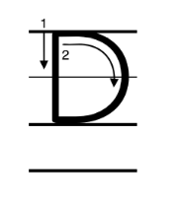
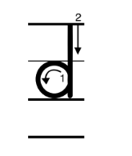
Handwriting
Notes:
Display the letters D and d by writing them on the board. Have students name the letters.
Model forming the uppercase and lowercase letters D and d.
Point out how both letters begin with the same lines but end differently. Then have students use their finger to air-write the letters.
Have students use Handwriting p. 81 from the Resource Download Center to practice writing the letters Dd. Click path: Table of Contents -> Resource Download Center -> Handwriting Practice -> U2W3L3 Handwriting Practice

Slide 43
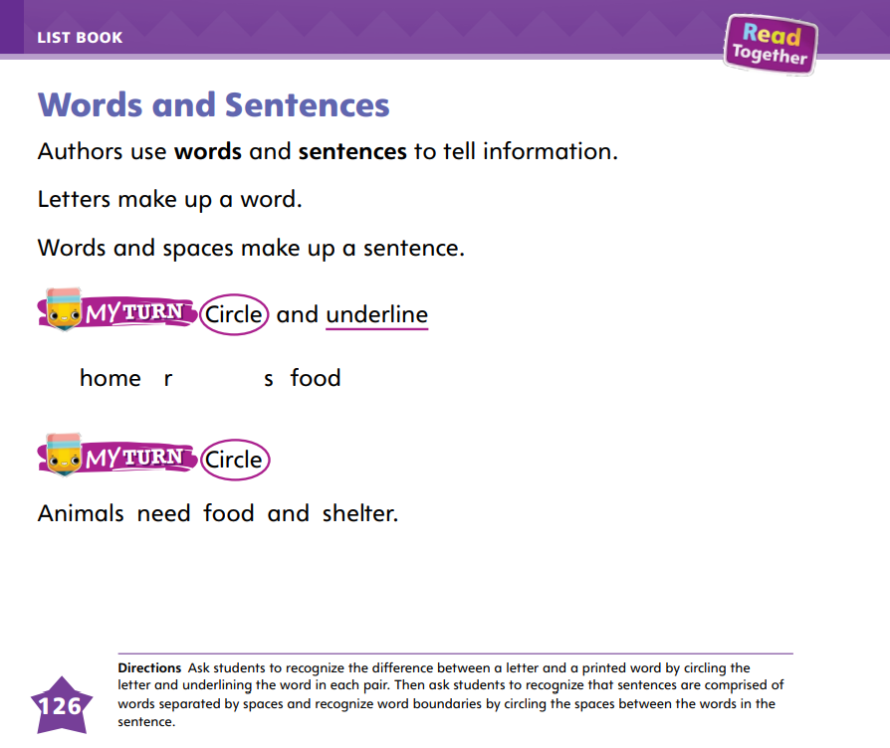
Page 126
Writing – List Book
Turn to page 126 in your Student Interactive.
Notes:
A word is made up of letters. A sentence is made up of words. Thin spaces are left between letters in a word; bigger spaces are left between words in a sentence. Leaving the correct spacing between words and letters allows readers to better read and understand a text.
Begin reading a book from the stack and pause when you get to a simple, complete sentence. Write the sentence on the board. This sentence has letters in it. It also has words.
Have a student circle a letter. There are many letters like this one in each word.
Have a student circle a word. Look at the difference between a letter and a word. You can see that a word is made up of letters. A sentence is made up of words.
Draw a box around the whole sentence.
Tell students that we are able to tell the difference between a letter and a word because of the spaces between the letters.
Have a student come up and draw a line between two letters. Have a different student come up and circle the space between two words. Look at the space between the letters and the space between words. How are they different? When we write our books, we need to add spaces between letters and bigger spaces between words.
Remind students that spoken words, when written, are made of letters that are in a specific order.
Have them point out the letter order of some of the words in one of the stack books as well as the spaces between letters and words.
Have students complete p. 126 of the Student Interactive.

Slide 44
Independent Writing
Let’s look at our spacing in our list book.
You will continue to work on writing in your list book.
Notes:
During independent writing time, students should review their own list books, checking each word and each sentence for proper spacing. They should fix any letters or words that have too little or too much space.
Then students can continue writing their list books.
• Modeled Choose another stack book and copy a sentence onto the board. Point out spaces between letters and words.
• Shared Have students rewrite a sentence from their book. Guide them to use proper spacing.
• Guided Use a stack book to provide explicit instruction about spacing between letters and words.
See the Conference Prompts on p. T350

Slide 45
Language and Conventions
Singular Verbs | Plural Verbs
skips
skip
climb
climbs
shouts
shout
Language and Conventions
dance
dances
Notes:
Review with students that a present tense verb tells about something that is happening in the present.
Provide the following words for student reference:
Provide a T-chart with the headings Singular Verbs and Plural Verbs. I look at the first two words: skips and skip. A singular verb that ends with -s tells about one person or thing. I know skips is a singular verb. I will write this word in the first column and skip in the second column.
Complete the chart by reading each word pair and asking students to figure out the singular and plural verbs.

Slide 46
Lesson 4

Slide 47
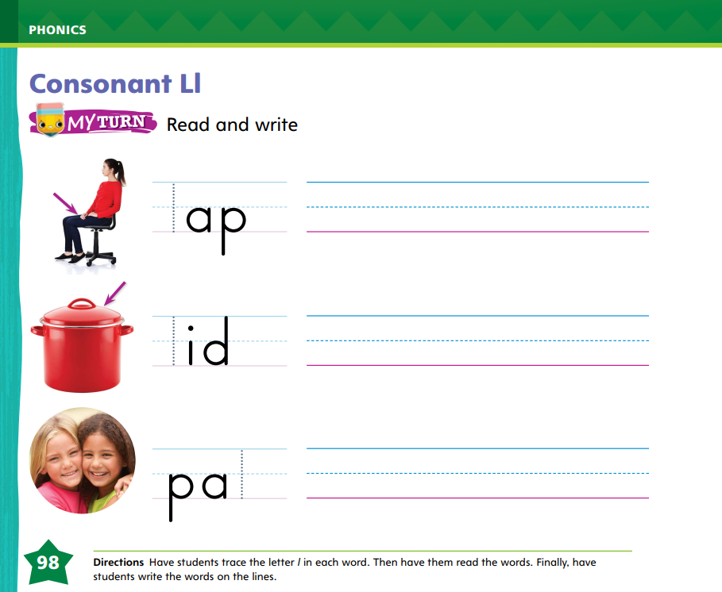
Page 98
Phonics
Notes:
Display Alphabet Card Ll. This is a picture of a lemon. I hear the sound /l/ at the beginning of lemon. The sound /l/ can be spelled with the letter l
Have students turn to p. 98 in the Student Interactive. Let’s look at the first picture on page 98. Can you find the arrow pointing to the person’s lap? Let’s decode the first word: /l/ /a/ /p/, lap. Trace the lowercase letter l. Then write the word lap on the line. Read the word lap.
Have students complete p. 98 in the Student Interactive.

Slide 48
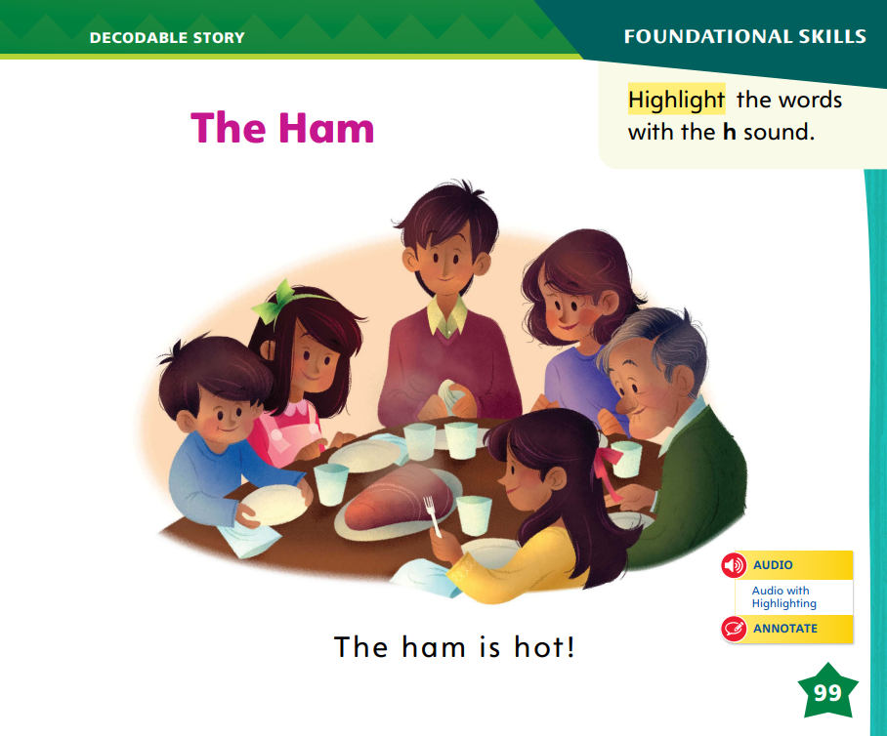
Page 99
Decodable Story
Turn to page 99 in your Student Interactive. Read “The Ham” with your partner.
Notes:
Have students turn to p. 99 in the Student Interactive. We are going to read a story today about some children who are eating ham.
Point to the title of the story. The title of the story is The Ham. I hear the sound /h/ at the beginning of the word ham. What other sounds that we learned do you hear in the word ham?
Students should come up with the sounds /a/ and /m/. In this story, we will read other words that have sounds you have learned.
Remind students of this week’s high-frequency words: one, two, three. Tell them they will practice reading these words in the story The Ham. Display the words. Have students read them with you. When you see these words in the story The Ham, you will know how to identify and read them.
Have students whisper read the story as you listen in.
Next, have students reread the story page by page with a partner. Listen carefully as they use letter sound relationships to decode. Partners should reread the story. This time the other student begins.

Slide 49
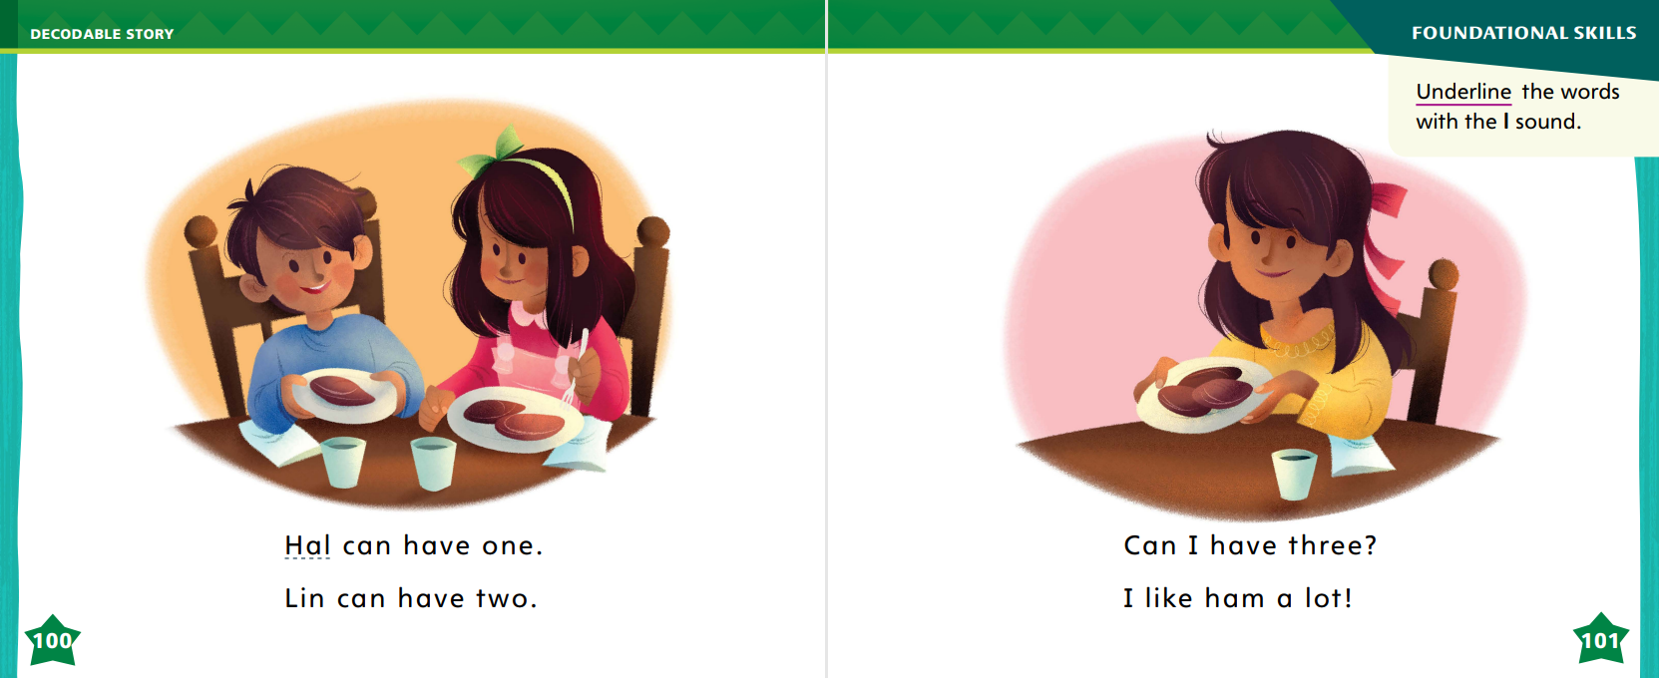
Page 100,101
Decodable Story
Notes:
After students have read the story, call their attention to the title. I see the letter h in this word: ham. What sound is at the beginning of the word ham? Help them identify, or say, the sound /h/. Then have them find and highlight the words with the sound /h/ spelled h on p. 99. I also see other sounds on the page that we already learned. Can you tell me the other sounds?
Help students identify, or say, the sounds /a/, /m/, /o/, /t/, and /i/.
Have students turn to pp. 100–101. Which words include the sound /l/? Point to them.
Help students identify, or say, the sound /l/. Then have them find and underline the words with the sound /l/.

Slide 50
Page 107
Make Connections
Notes:
Explain that making connections helps us understand a story. When we think about what the story reminds us of, we make connections. Give examples of connections they could make.
• If the story events remind us of something we have done, we can use that to understand the story better.
• We can think about how the characters feel and times we felt the same way. This helps us understand the characters.
• We can ask ourselves if the story is like another story we know. We can use our past reading experience to make connections.
Model connecting to Do We Need This? I can connect to Mia. She didn’t seem to know much about camping. I’m like that too. I know how she must have felt when she kept bringing the wrong things to Alex. Making connections helped me understand and enjoy the story more.

Slide 51
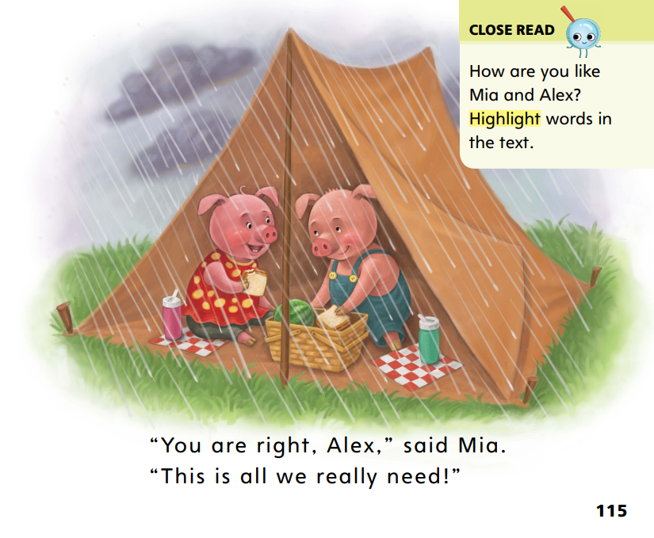
Page 115
Close Read – Make Connections
Notes:
Have students reread the Close Read note on p. 115 in the Student Interactive and highlight words that reminded them of something.
Have students tell a partner what connections they can make to the text. Provide assistance as needed.

Slide 52
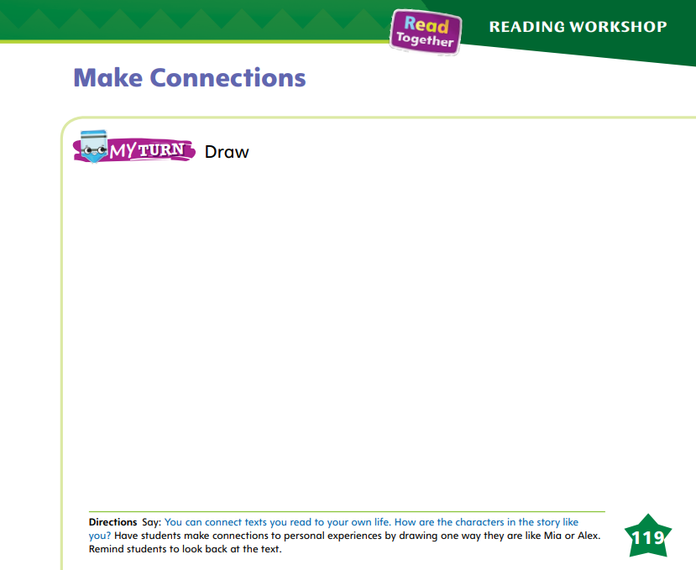
Page 119
Make Connections
Turn to page 119 in your Student Interactive and draw a picture.
Notes:
Have students tell a partner how they are like either Mia or Alex.
Then ask them to draw a picture on p. 119 in the Student Interactive that shows how they are like the character.

Slide 53
Writing – List Book
What detail did the author decide to put first?
What detail did the author put next?
Notes:
Authors organize their ideas so the reader can follow along in the book. When writing, the most important ideas or details go first, and other ideas and sentences follow.
Pull a book from the stack and read it aloud with the class. Ask students to think about how the information in the text is organized. The author put the information in order. What detail did the author decide to put first?
Have students recall what detail came first. Display the first page of the book to guide them. What detail did the author put next? Guide students to continue naming the details in order.
Explain to students that the author organized the details.
Depending on the structure of the book you read, explain that the details are organized with the most important detail first, or the details are organized in chronological order.
Pull another book from the stack and repeat the process of identifying the details and the order in which the writer presents them. How would the book be different if the details were in a different order?

Slide 54
Independent Writing
Now you will reread your list book to make sure the details are organized and make sense.
It is okay to rewrite your book if you think of a better way to organize the details.
Notes:
During independent writing time, students should reread their list books to make sure the details are organized in an order that makes sense. Tell them that it is OK to rewrite their books if they think of a better way to organize the details.
If their details are organized, they should continue writing.
• Modeled: Think aloud as you talk through how the details of a stack text are organized.
• Shared: Have students choose a stack text, and together talk through how the details are organized.
• Guided: Prompt students to think about other ways they could arrange details of a stack text.
See the Conference Prompts on p. T350
As students write, use the conference prompts in the Teacher’s Edition or Resource Download Center to provide support. Click path: Table of Contents -> Resource Download Center -+ Writing Workshop Conference Notes

Slide 55
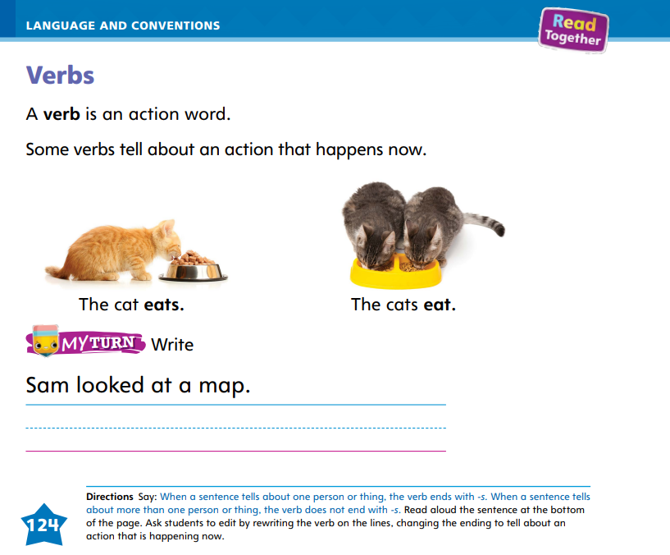
Page 124
Language and Conventions
Turn to page 124 in your Student Interactive and complete the activity.
Notes:
Have students edit for a verb on p. 124 in the Student Interactive.
Depending on your students, have them work with a partner, independently, or with teacher guidance.

Slide 56
Lesson 5

Slide 57


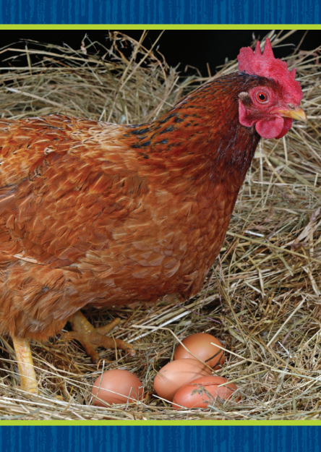
Phonological Awareness
Notes:
Display Picture Card hat. Listen to the sounds as I say this word slowly: /h/ /a/ /t/. Now I can say the sounds quickly and blend them together: hat.
Use Picture Cards lake, leaf, and hen. Show each picture and say what it is. For each picture, have students say each individual sound in the word, pausing between each sound. Then have them say each sound quickly, blending them together to say the word.

Slide 58
Page 102,103
Phonics
H h
L l
lip
hop
hat
lot
hot
Lin
him
Notes:
Write the letters Hh and Ll on the board. Have students identify the letters as you point to them. Then review the sound for each letter.
Write an uppercase letter H or L on several index cards. Give one card to each student.
I am going to say some words. If a word starts with the sound /h/ and you have a card with the letter H on it, stand up. If a word starts with the sound /l/ and you have a card with the letter L on it, stand up.
Say the following words one at a time, and guide students to stand as needed: lip, hot, hop, lot, Lin, hat, him. Then display each word and have students read it. Point to each letter as you say each word. Let’s read this word together: /h/ -ot, hot.
Repeat with these words: hop, lot, lip, Lin, hat, him.
Have students turn to p. 102 in the Student Interactive and read the words in each row. Have them write the letter that is the same in all three words on the line. Then have them complete the activity on p. 103.

Slide 59
High-Frequency Words
one
two
three
Notes:
(Note: Move the orange boxes to cover each bold spelling word before you read aloud the words .)
Remind students that high-frequency words are words that they hear, read, and say often.
Say the word one and ask students what letters spell the word. Have students
• say the letters as you write them on the board.
• say and spell the word, clapping their hands for each letter.
• Repeat with the words two and three.

Slide 60
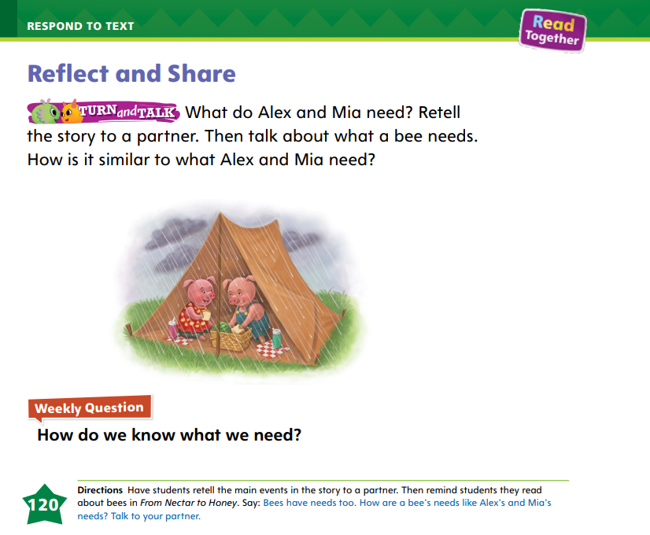
Page 120
Reflect and Share
Turn to page 120 in your Student Interactive.
Notes:
Tell students that, when they talk about different texts in a discussion, they need to:
• listen to what others have to say and not interrupt.
• add to the comments of others.
• tell what is the same about the texts and what is different.
Ask students to think about the text they read last week, From Nectar to Honey. This text is an informational text that told me facts about how bees make honey. Bees need flowers so they can make honey. The book we read this week is about what Mia and Alex need. Talk about what bees need. Do bees need food? Do bees need to drink? Do bees need shelter?
Tell students that bees drink nectar from flowers and they live in a hive. Ask partners to retell the story about Mia and Alex. Then have them tell how what these characters need is similar to what a bee needs.

Slide 61
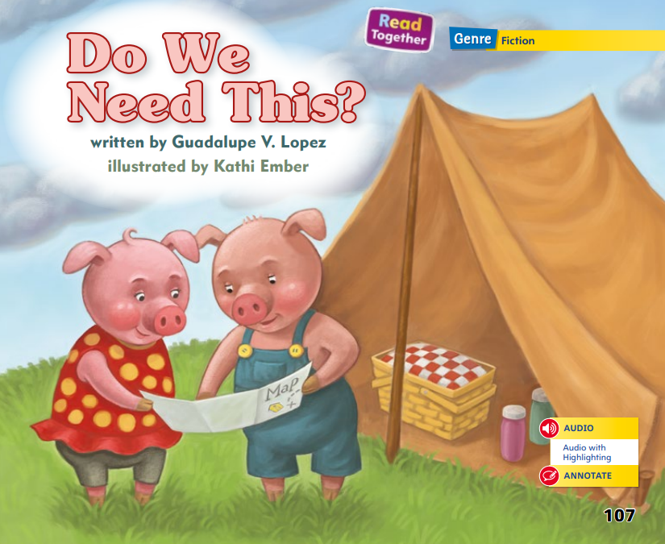
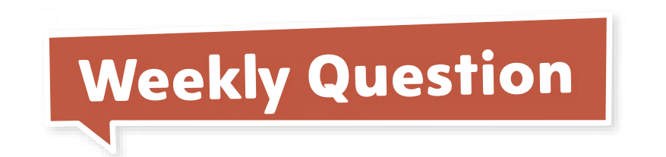
Page 107
Apply
How do we know what we need?
Notes:
Have students turn to p. 120 in the Student Interactive and complete the Turn and Talk.
If desired, distribute Collaborative Conversations tips from the Resource Download Center to help guide discussions .Click Path: Table of Contents -> Resource Download Center -> Speaking and Listening
Have students use evidence from the texts they have read this week to respond to the Weekly Question.
Tell them to discuss in small groups or write or draw their responses on a separate sheet of paper.

Slide 62
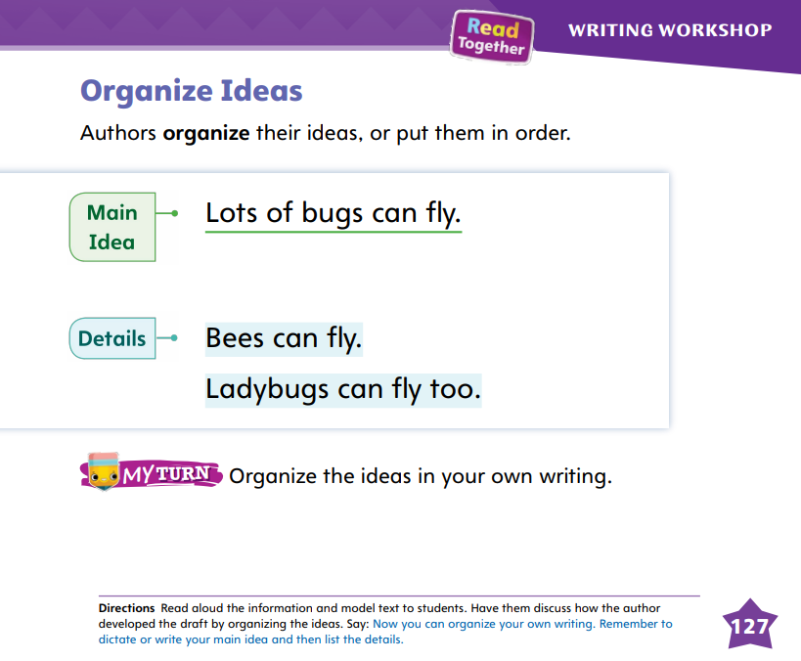
Page 127
Writing – List Book
Turn to page 127 in your Student Interactive.
Notes:
Authors organize their books by stating the main idea first and then listing the details. Details should be listed in an order that makes sense, such as chronologically or in the order of importance.
Pull a book from your stack and read it aloud with the class. Ask students to tell what the book is mostly about.
Next, ask students to list some of the details that helped them decide. The author of this book put the details in an order that makes sense. When we write our books, we will also put the details in order.
Tell students that you are going to write a list book about animals you saw at the zoo. Write the following words on flashcards: monkeys, penguins, lions, hippopotamuses. Display them for students.
.I am going to put my details in order. I can organize my details in the order in which I saw the animals. When I got to the zoo, I saw the penguins. Then I saw the monkeys. Then I saw the lions. Last, I saw the hippopotamuses.
Place the flashcards in order.
There isn’t one correct way to organize your details. As the author, you get to decide the way you will organize them.
Ask students if they can think of any other way to organize the details. You might organize them in alphabetical order, by size, or by how close they live to the ground.
Invite them to come up and place the flashcards in order and explain the reason for the organization.
Have students turn to p. 127 in the Student Interactive. Read the page together

Slide 63
Language and Conventions
Which group of words is a simple sentence?
1. Jim ____ to school. (walks, walk)
2. He _____ dogs. (like, likes)
3. She _____ running. (start, starts)
4. We _____ food to stay alive.
Notes:
Display the following:
1. Jim ____ to school. (walks, walk)
2. He _____ dogs. (like, likes)
3. She _____ running. (start, starts)
4. We _____ food to stay alive.
Read sentences 1–3 one at a time and have students tell which present tense verb belongs in the blank.
Read sentence 4 and ask students to think of a present tense verb to finish the sentence
4. Provide more practice with present tense by having students complete Language and Conventions, p. 88, from the Resource Download Center. Click path: Table of Contents -> Resource Download Center -> Language and Conventions -> U2 W3

Slide 64
Unit 2: Week 3
Grade K

